Slide 1
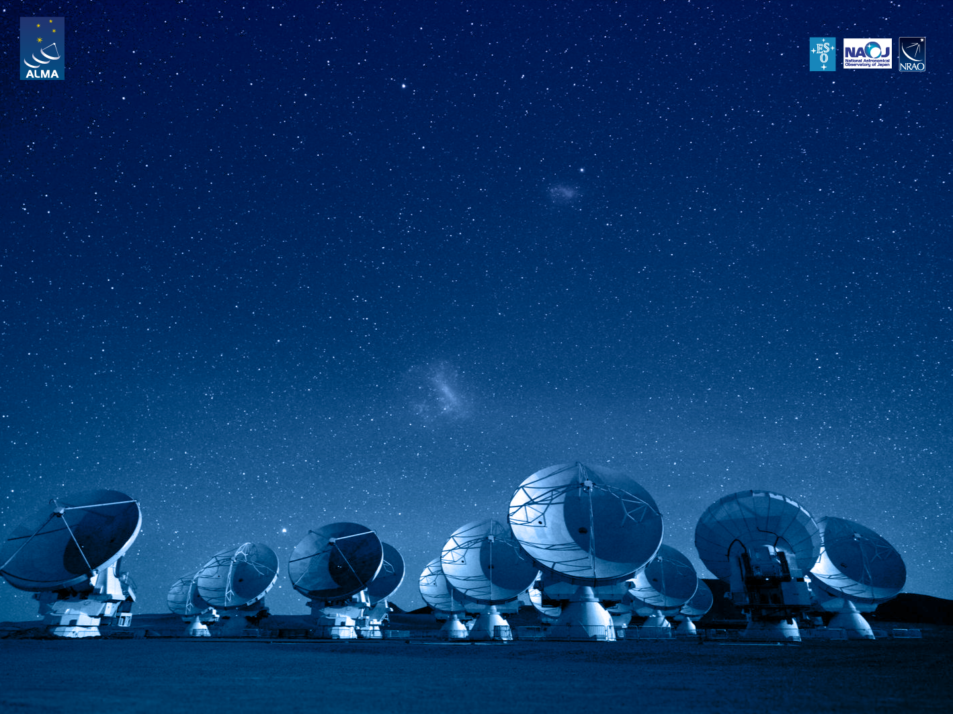
ALMA Common Software Basic Track
Logging and Error Systems

Slide 2
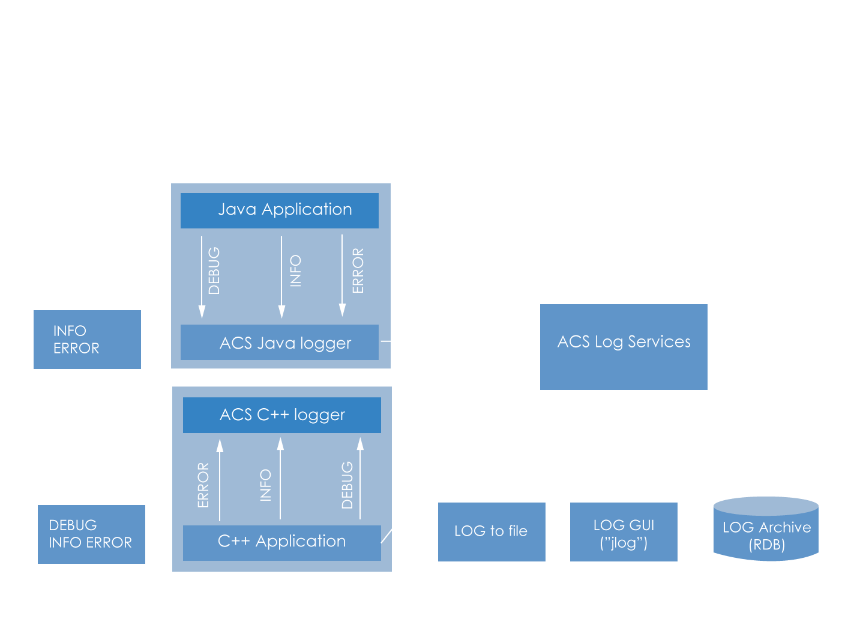
Logging system conceptual overview

Slide 3
Logging system
The logging system provide
status and diagnostic information
historical archive
filtering capabilities by level/audience
Several logging levels:
Trace (1), Delouse (2), Debug (3), Info (4), Notice (5), Warning (6) , Error (8), Critical (9), Alert (10), Emergency (11), Off (99)
Three logging audiences (orthogonal to log levels):
ENGINEER, OPERATOR, SCILOG
They are essential for post-mortem analysis
They are normally intended for developers and operators

Slide 4
Logging system
Logging service:
Transport through a notification channel
Graphical user interface to visualize them in runtime or offline (jlog)
For later processing can be:
written to file
stored in DB
For high performance / robustness:
Transparent caching
Transfer asynchronously in batches
Transparent insertion of additional data:
host / container names
thread name
Warning: Every logging client considerably slows down the logging system! Congestions can lead to a logging service crash

Slide 5
Repeat guards: preventing log flooding
Conveniently reduce number of executions of identical activity
e.g. Logging of same log message, e.g. “incident detected”, N times/s
Can be used for other activities, is wrapped around activity
Configurable based on:
Number of executions
Time interval
Combinations of both

Slide 6
Log entry example
<Debug
TimeStamp="2002-10-7T13:44:16.530" Host=“te1.hq.eso.org“
Process="baciTestServer“
Thread="main"
Context="“
File="baciTestClassImpl.cpp“
Line="205" Routine="BaciTestClass::~BaciTestClass
>

Slide 7
Logging system configuration
Default configuration
log TRACE and above levels
Optional environment variables can set per-process log levels
CDB can set per-process log levels / per-logger level
Tools to dynamically change log levels in running system
Environment variables:
Log level for console: $ACS_LOG_STDOUT
Central logging level: $ACS_LOG_CENTRAL
Log file name: $ACS_LOG_FILE

Slide 8
Error system
ACS: faults or errors are a situation that requires handling
Handled by developer
Helpers (acserr.idl):
Completion
Not critically failed execution / execution OK
Errors
Critically failed execution
ACS (CORBA) exceptions predefined in XML (ACSErrTypeCommon.xml, ACSErrTypeCommon.idl)
Error propagation → Error trace
Chaining of Completions
Chaining of errors / ACS exceptions
Possible across process boundaries

Slide 9
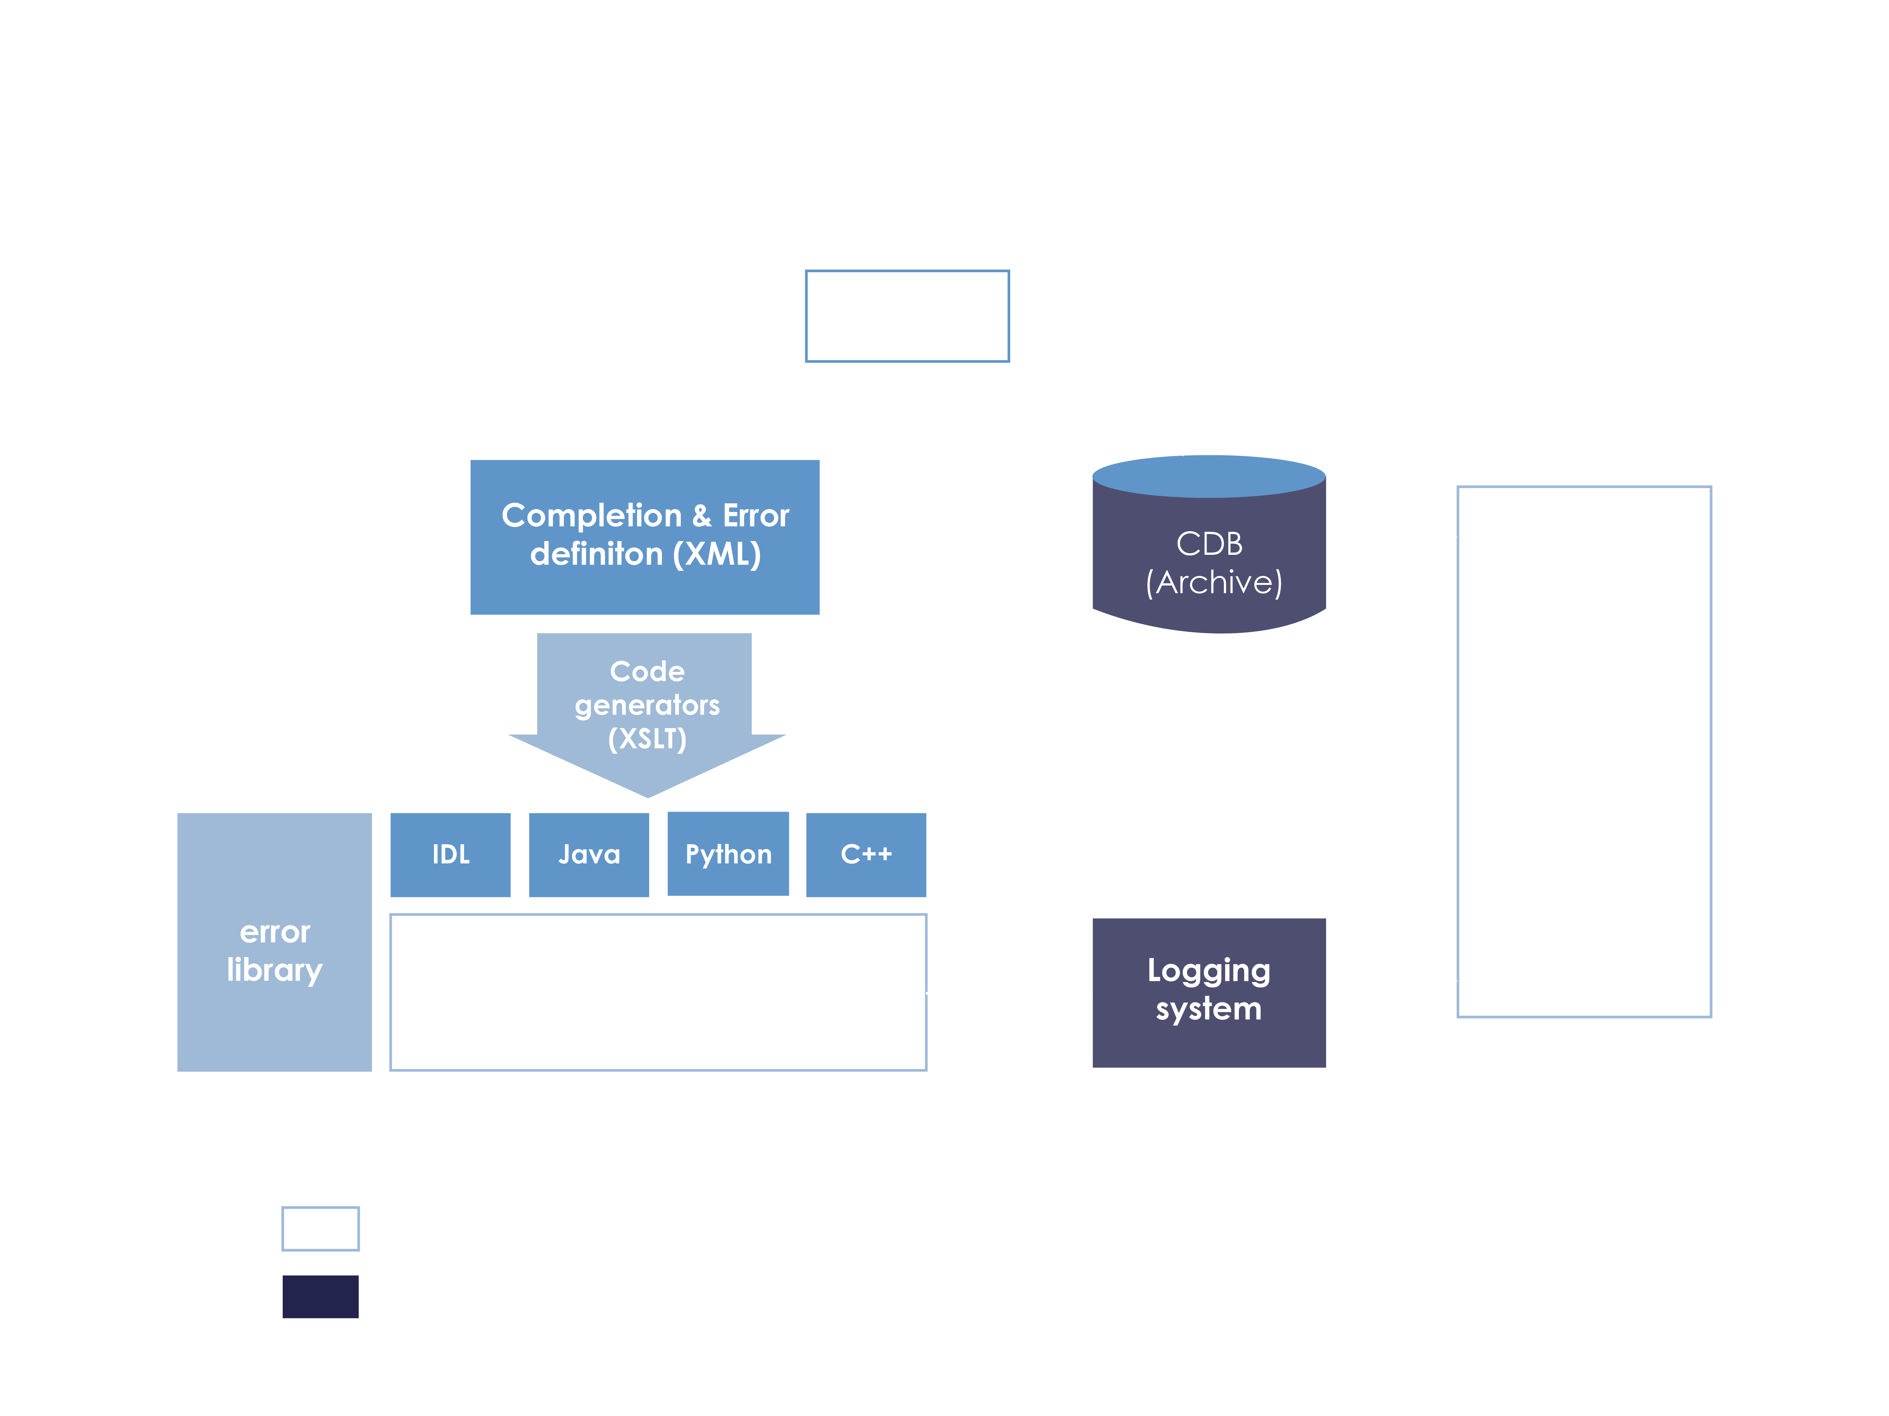
Error system conceptual overview

Slide 10
Resources
Logging and Archiving:
http://www.eso.org/projects/alma/develop/acs/OnlineDocs/Logging_and_Archiving.pdf
Definitive guide to logs and errors
http://almasw.hq.eso.org/almasw/bin/view/HLA/LoggingErrorAlarmsGuidelines
And of course, the source code

Slide 11
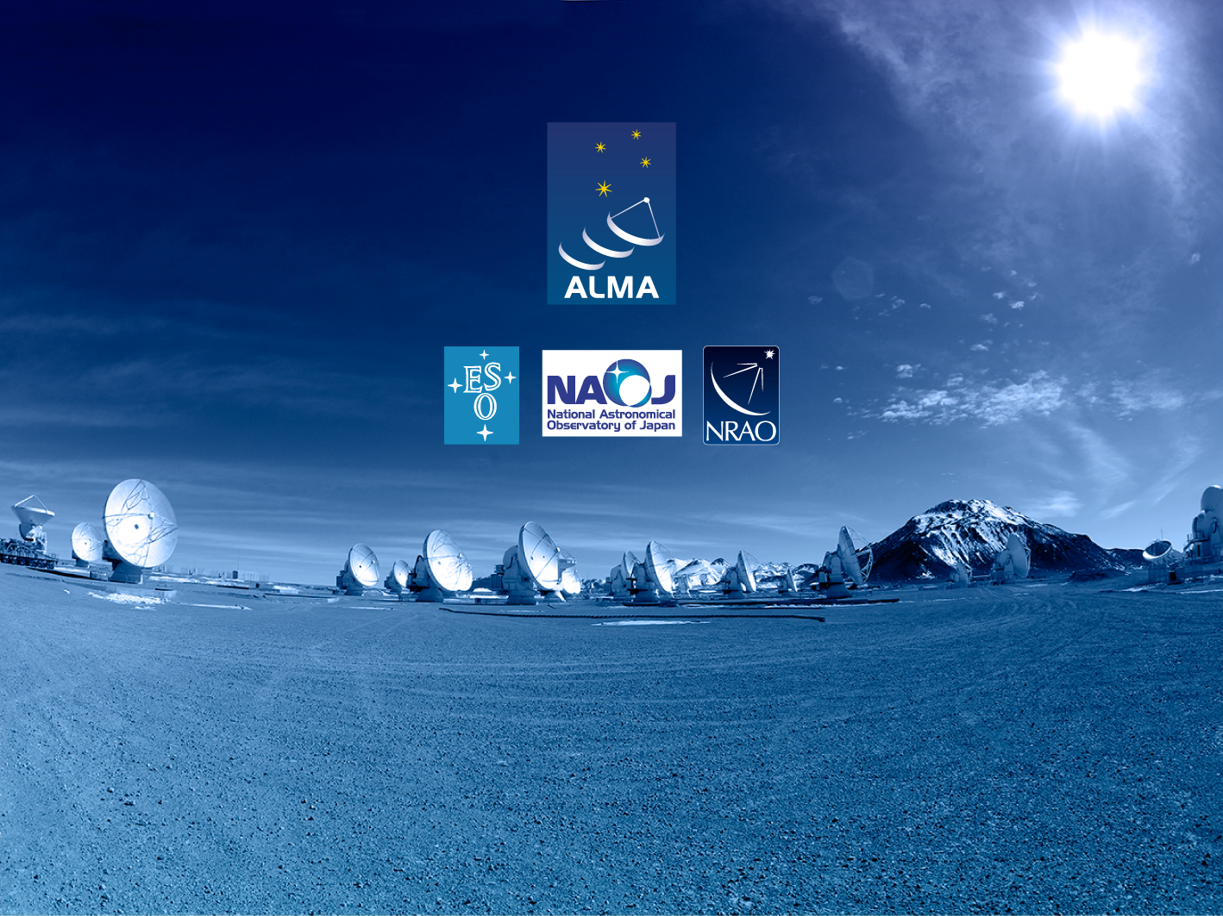
Questions?
Acknowledgements
ACS presentations were originally developed by the ALMA Common Software development team and has been used in many instances of training courses since 2004. Main contributors are (listed in alphabetical order): Jorge Avarias, Alessandro Caproni, Gianluca Chiozzi, Jorge Ibsen, Thomas Jürgens, Matias Mora, Joseph Schwarz, Heiko Sommer.
The Atacama Large Millimeter/submillimeter Array (ALMA), an international astronomy facility, is a partnership of Europe, North America and East Asia in cooperation with the Republic of Chile. ALMA is funded in Europe by the European Organization for Astronomical Research in the Southern Hemisphere (ESO), in North America by the U.S. National Science Foundation (NSF) in cooperation with the National Research Council of Canada (NRC) and the National Science Council of Taiwan (NSC) and in East Asia by the National Institutes of Natural Sciences (NINS) of Japan in cooperation with the Academia Sinica (AS) in Taiwan. ALMA construction and operations are led on behalf of Europe by ESO, on behalf of North America by the National Radio Astronomy Observatory (NRAO), which is managed by Associated Universities, Inc. (AUI) and on behalf of East Asia by the National Astronomical Observatory of Japan (NAOJ). The Joint ALMA Observatory (JAO) provides the unified leadership and management of the construction, commissioning and operation of ALMA.

